Slide 1

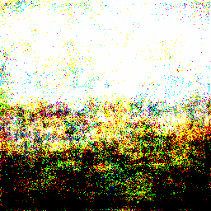
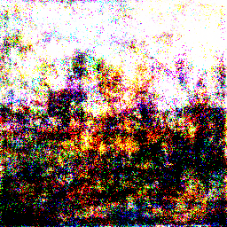
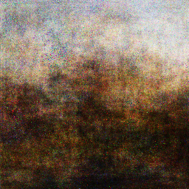
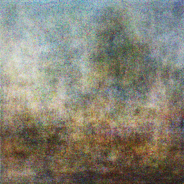
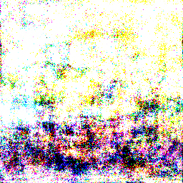
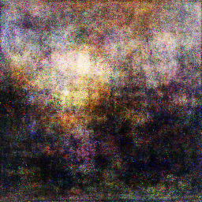
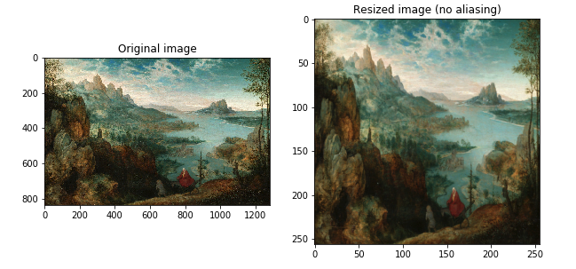
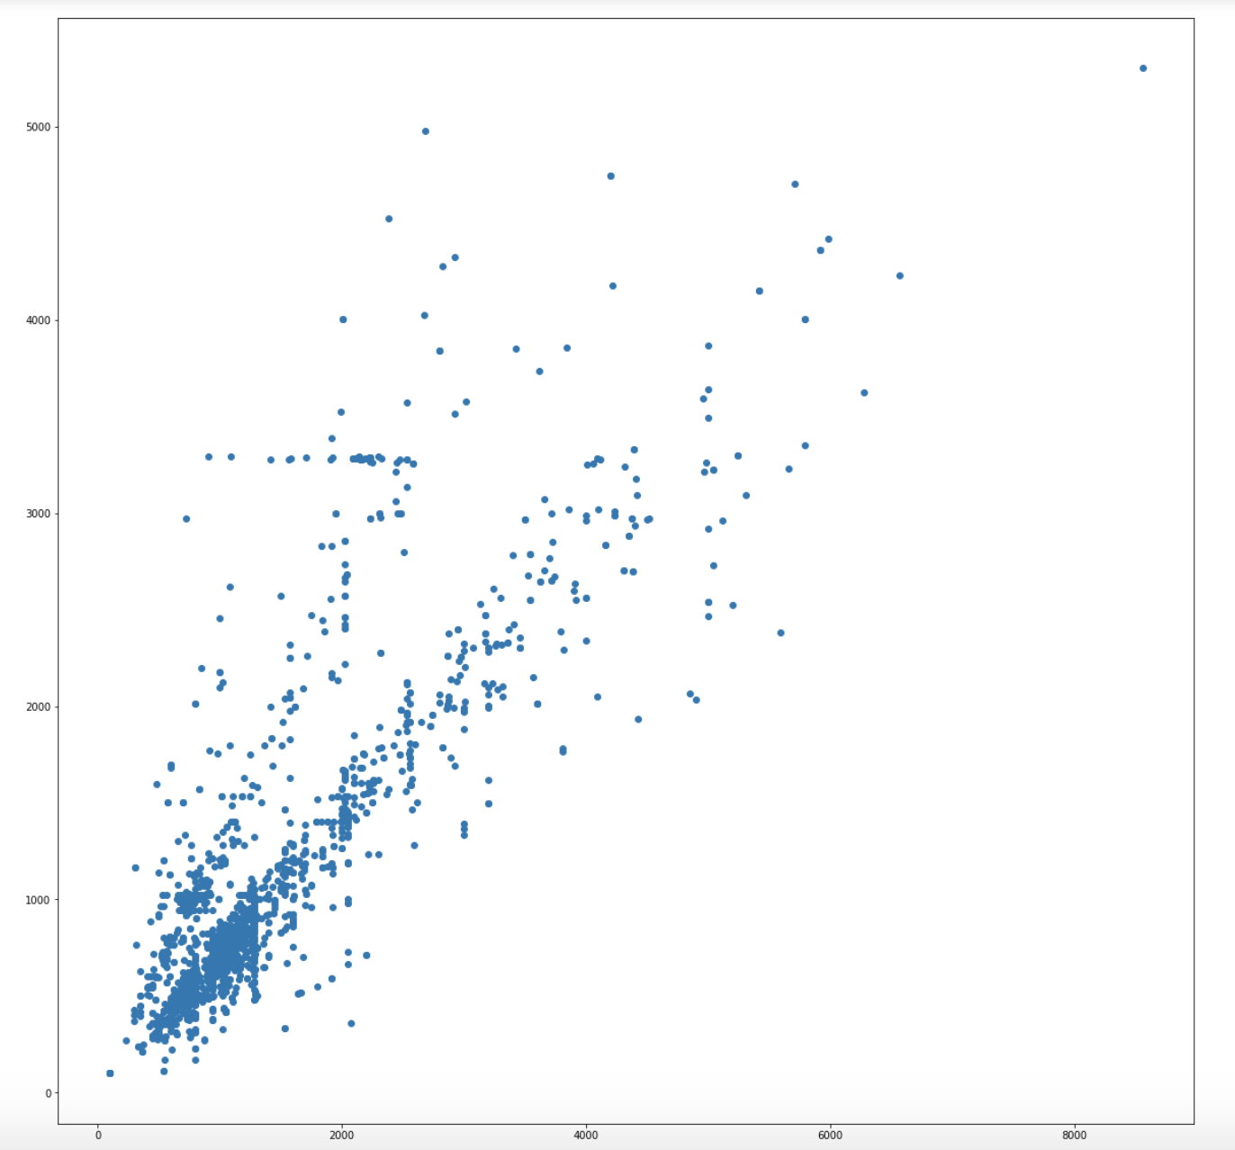
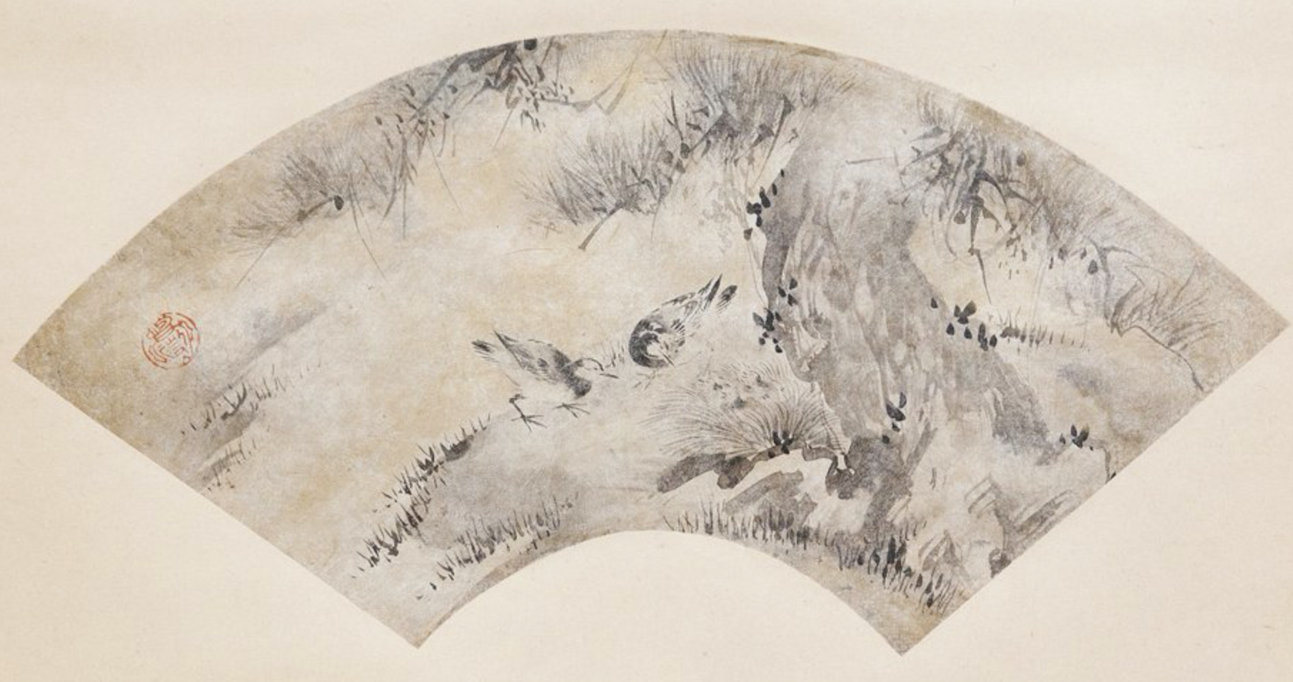
COMP 576 Intro to Deep Learning Final Project - Artificial Art
Jonathan Cai (jmc31), Skylar Xu (yx48)
Rice University, Computer Science
Abstract
Results
We attempt to replicate studies that have generated art by using Generative Adversarial Networks (GANs), simulating a given distribution of images. We have chosen a dataset of landscape images taken from WikiArt.
Introduction
Recently, there have been many developments in the area of Generative Adversarial Networks. In particular, GANs have been used to generate creative pieces, including paintings, music, faces etc.
This poses a philosophical question - what is art? Does it require a painter’s skilled hand and creative mind to produce a painting, or can a machine do the same?
We’re not sure if we can ever answer these questions, however we are interested in seeing if we can replicate these studies, while exploring the usefulness of GANs in art generation.
Figure 4. GAN Architecture. We’ve defined the latent space (the random noise) to be R¹⁰⁰ . Also, this diagram depicts the MNIST dataset, but our dataset is much more complicated images of landscapes. It is also worth mentioning that the results of the combined model are back-propagated throughout each model to fit both the discriminator and the generator.
Methodology
Conclusions
Preprocessing:
The performed preprocessing was simple. We scaled every image in our dataset into dimensions 256 x 256. We also needed to prune the dataset, removing images that were far too small to be reasonably comprehensible (there was a cluster of 100 x 100 images) and images that were simply not depicting any sort of landscape.
Architecture:
The generator was modeled as so:
The discriminator was modeled as so:
Click here to insert your Conclusions text. Type it in or copy and paste from your Word document or other source.
This text box will automatically re-size to your text. To turn off that feature, right click inside this box and go to Format Shape, Text Box, Autofit, and select the “Do Not Autofit” radio button.
To change the font style of this text box: Click on the border once to highlight the entire text box, then select a different font or font size that suits you. This text is Calibri 20pt and is easily read up to 3 feet away on a 24x36 poster, and up to 6 feet away on a 48x72 poster.
Zoom out to 100% (for 24x36) or 200% (for 48x72) to preview what this will look like on your printed poster.
Discussion
Click here to insert your Discussion text. Type it in or copy and paste from your Word document or other source.
This text box will automatically re-size to your text. To turn off that feature, right click inside this box and go to Format Shape, Text Box, Autofit, and select the “Do Not Autofit” radio button.
To change the font style of this text box: Click on the border once to highlight the entire text box, then select a different font or font size that suits you. This text is Calibri 20pt and is easily read up to 3 feet away on a 24x36 poster, and up to 6 feet away on a 48x72 poster.
Zoom out to 100% (for 24x36) or 200% (for 48x72) to preview what this will look like on your printed poster.
Figure 1. Visualization of the image rescaling.
Figure 2. Example image that was manually
removed from the dataset
Figure 3. Distribution of image dimensions in the dataset
Contact
References
Jonathan Cai
Email: jmc31@rice.edu
Skylar Xu
Email: yx48@rice.edu

